Slide 1

PA 604
EXPERIMENTS
PROFESSOR BURREL VANN JR

Slide 2
OBSERVING
measuring an outcome of interest
ACTION(S)
EXPERIMENTS INVOLVE
having participants do something, or doing something to participants
OBSERVING AGAIN
measuring changes in the outcome of interest (consequences of the action)

Slide 3

EXPERIMENTS AND CAUSATION
EXPERIMENTS FOR EXPLANATORY (CAUSAL) PURPOSES
Example: You hypothesize that learning about Muslim contributions to U.S. history will reduce prejudice.
To test hypothesis in an experiment, you would:
measure prejudice
expose participants to documentary/videos that depict Muslim contributions
measure prejudice, again (to see if it reduced)
Testing hypotheses

Slide 4



THE CLASSICAL EXPERIMENT
Independent and Dependent Variables
Pre-testing and
Post-testing
Experimental and Control Groups

Slide 5

INDEPENDENT
A stimulus or cause
dichotomous (either present or absent, exposure or not)
INDEPENDENT AND DEPENDENT VARIABLES
DEPENDENT
An outcome or effect

Slide 6
PRE-TESTING
Measuring the dependent variable (outcome) among participants before they are exposed to the stimulus
POST-TESTING
Measuring the dependent variable (outcome) among participants after they are exposed to the (present or absent) stimulus
PRE-TESTING AND POST-TESTING
Notes:
some problems with validity in experiments is that subjects/participants may react differently in the post-test simply because they are being asked again, even if their attitudes/beliefs are unchanged.

Slide 7
EXPERIMENTAL GROUP
Participants who are exposed to the stimulus
the independent variable is present
CONTROL GROUP
Participants who resemble the experimental group in all respects, but who are not exposed to the stimulus
Often exposed to placebo/something neutral that is not intended to affect outcome
EXPERIMENTAL AND
CONTROL GROUPS
Notes:
1: having control groups allows us to see if there are effects of the experiment itself. If both groups change in the same direction and to the same degree... then those changes ARE NOT the result of the stimulus.
2: there is the possibility of the hawthorne effect, wherein groups change as a result of being studied... such that the experimental group experiences changes after exposed to the stimulus... but even after stimulus is removed and still being studied, experimental group continues to change..
3: Why introduce a placebo to the control group. In short, we want both groups to be similar in all respects... this means that both groups should be exposed to SOMETHING... either the experimental stimulus or something neutral (one that should NOT influence the outcome).

Slide 8

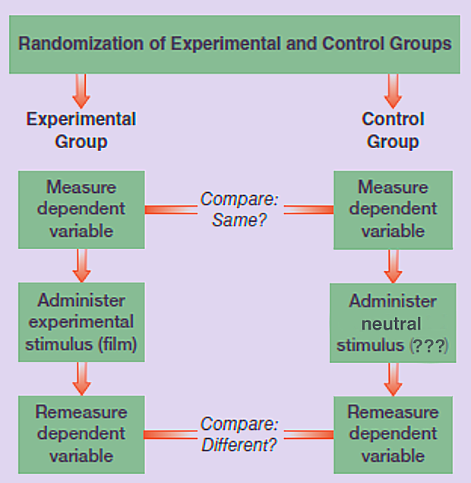
THE CLASSICAL EXPERIMENT

Slide 9
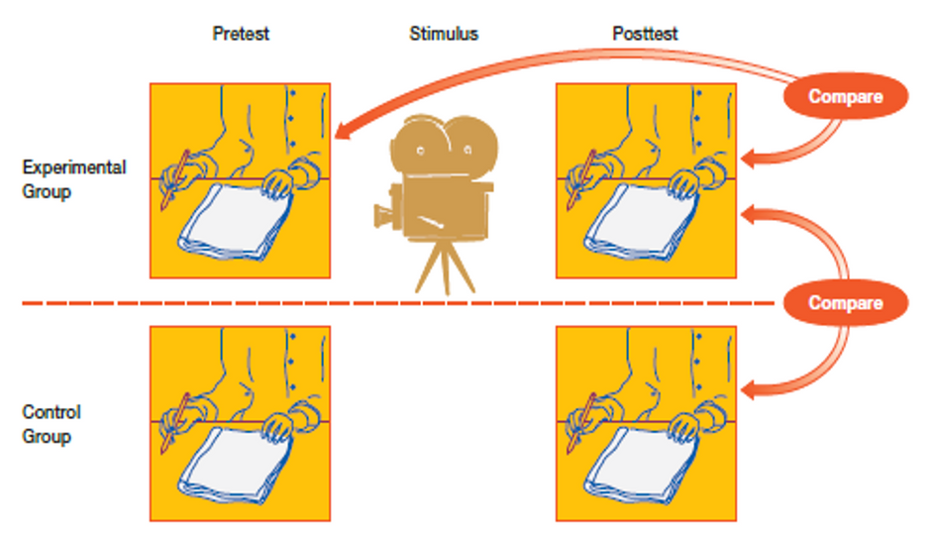
THE CLASSICAL EXPERIMENT
AN EXAMPLE

Slide 10
A version of the classical experiment in which neither the participants nor the researcher know who is in which group
THE DOUBLE-BLIND EXPERIMENT

Slide 11
EXPERIMENTS,
THE UNIVERSITY, AND GENERALIZABILITY
We want social research findings that are generalizable to the population. This means that the sample must be representative of the population.
However, because many researchers are university professors, their experiments tend to rely on undergraduate students as participants
How would we ensure that our findings are generalizable?
If not possible, how do we ensure our findings are valid?

Slide 12
PROBABILITY SAMPLING
Selecting Participants
(for representativeness)
Representative if:
Sample size is large enough
Entire sample of participants comes from probability sampling frame
Each group (experimental and control) is drawn from participants based on probability sampling frame
Notes:
Although attempting to create probability samples is highly preferred/suggested, many researchers can't or don't do this... and many often rely on small samples of N=100 (50 per).
Because researchers cannot, or do not want to, attempt representativeness that would allow them to generalize the findings from their research to the population... and because non-response, in recent years, has been increasing (which leaves us more and more with non-probability samples), researchers focus instead on making sure the two groups look exactly alike in all respects...
to ensure similarity between experimental and control groups, researchers engage in random assignment to groups, and/or matching between groups.

Slide 13
RANDOM ASSIGNMENT
Selecting Participants
(for similarity between groups)
Randomly assigning participants to either experimental group or control group
Use random number generator to assign people to each group based on number
Participants have equal chance of being in either group

Slide 14
QUOTA MATCHING*
Selecting Participants
(for similarity between groups)
Selecting participants' group in attempt to match relevant characteristics across groups
Create quota matrix of all relevant characteristics (e.g. sex, age, race, etc.)
Divide total in each cell of quota matrix equally between experimental and control groups
*least preferred method of participant selection

Slide 15
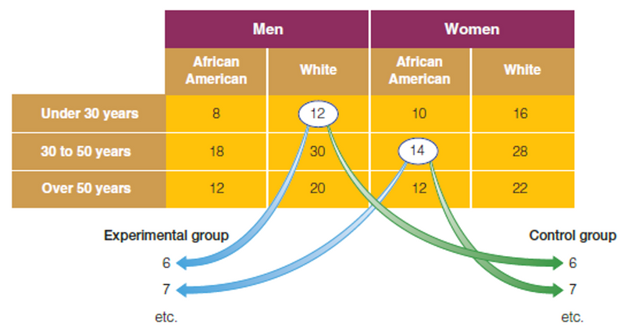
QUOTA MATCHING*
Selecting Participants
(for similarity between groups)
*least preferred method of participant selection
Notes:
quota matrix is an n*n matrix. the number of cells in the matrix is the multiple of the attributes within each relevant variable.
So if sex is 3 (male, female, other), race/ethnicity is 6 (white, black, latinx, asian, native, other), and political ideology is 3 (liberal, moderate, conservative), and you decide that these are the only three relevant characteristics for your study... then the quota matrix would be:
3*6*3 = 54 unique cells big.

Slide 16
BEST
Probability Sampling + Random Assignment
BEST METHODS FOR SELECTING PARTICIPANTS
SECOND BEST
Random Assignment (within Non-Probability Sample)
THIRD BEST
Matching (within Non-Probability Sample)
Notes:
Researchers should always attempt to get a probability sample, then randomize assignment to groups.
However, most cant... so if conducting experiments with non-probability samples, the researcher should try to their best to make groups look alike... and the best way is use randomization. Later, researchers could use post-stratification weights to make the non-probability sample "match" the population.
The last choice a researcher should use is matching for assignment. Matching is great when used as a post-stratification technique when trying to match the population by weighting the results. Hand picking who goes where in experiments introduces bias... which can simply be avoided through random assignment.
If stuck with non-probability samples, and stuck between random assignment and matching... choose random assignment. This is because, with matching, we can never truly know what a "relevant" characteristic or variable is. Moreover, most statistical tests assume randomization. Moreover, with large enough samples, random assignment will ensure equality between groups, as well as equality between full sample (experimental and control groups) and the population.

Slide 17
INTERNAL VALIDITY ISSUES
Possibility that anything other than the stimulus can affect the outcome
history, maturation, testing, instrumentation, statistical regression, selection bias, experimental mortality, causal time order, diffusion or imitation of treatments, compensation, compensatory rivalry, demoralization
EXTERNAL VALIDITY ISSUES
VALIDITY ISSUES IN EXPERIMENTS
Possibility that results may not be generalizable to the "real" world

Slide 18
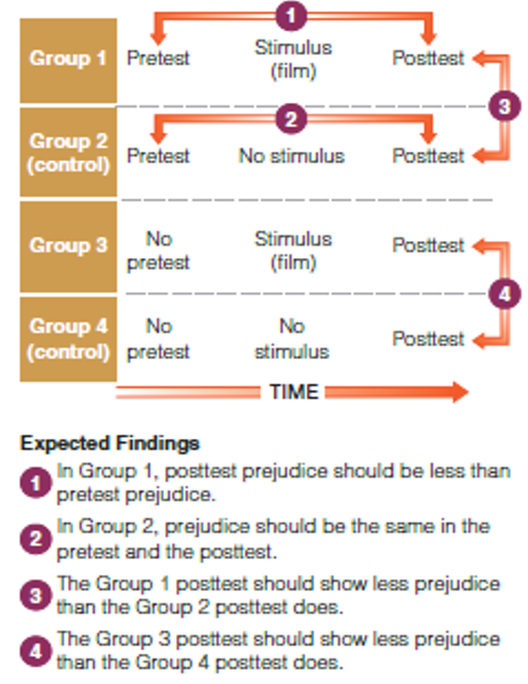
ADDRESSING VALIDITY ISSUES
THE SOLOMON FOUR-GROUP DESIGN

Slide 19
TYPES OF CLASSICAL EXPERIMENTS
LAB
EXPERIMENT
FIELD EXPERIMENT
Experiment in which participants are required to come into the lab to participate in the research study.
Classical Experiment traditionally seen as a Lab Experiment
Experiment that take place outside the lab, in the real world.
Stimulus and measurement instruments (often surveys) are sent to participants via mail or web (internet links, websites, emails)
Field experiments, especially web-based experiments are currently most common
Notes:
Researchers using the field experiment model often rely on non-probability samples (using Amazon's Mechanical Turk -- MTurk -- sample management system), and web-based surveys administered via Qualtrics, Google Forms, Survey Monkey, or LimeSurvey.
To increase external validity, researchers often use post-stratification weights (or multilevel regression -- within groups of the quota matrix -- with post-stratification) to match the characteristics of a desired population.

Slide 20
NATURAL EXPERIMENT
Experiment in which stimulus (sometimes called the treatment) has already naturally-occurred.
Quasi-Experimental because lacks pre-test comparison, and stimulus not under researcher control.
Used in disaster research, effect of disaster on those who experienced it
A QUASI-EXPERIMENT

Slide 21
STRENGTHS
Causation: Isolation of independent variable's/stimulus' impact on outcome
Replication
STRENGTHS AND WEAKNESSES OF EXPERIMENTAL DESIGNS
WEAKNESSES
Artificiality: External validity problems
Notes:
some problems with validity in experiments is that subjects/participants may react differently in the post-test simply because they are being asked again, even if their attitudes/beliefs are unchanged.

Slide 22
Ethics and Experiments
Deception for the stimulus, requires debriefing
Obtrusive: has potential to inadvertently harm participants

